Slide 1

Deep Learning in Physical Layer
Deep Learning-Based Detector for OFDM-IM
Department of Electronic Communication Engineering
Liu Yu-Chen
0840042
T. V. Luong, Y. Ko, N. A. Vien, D. H. N. Nguyen and M. Matthaiou, "Deep Learning-Based Detector for OFDM-IM," in IEEE Wireless Communications Letters, vol. 8, no. 4, pp. 1159-1162, Aug. 2019.

Slide 2
Background (1)
Deep Learning (DL) adopts Deep Neural Network (DNN) to construct nonlinear mapping between different presentations of data^{[1]}
Computer Vision
Data Miming
Nature Language Processing
The topic about implementing DL on communication has been discussed for a long time. But a majority part of researches under this theme mainly focus on application layer and network layer^{[2]}
Span Mail Recognition
Network Clustering
Queue Theory
[1]Z. Qin, H. Ye, G. Y. Li and B. F. Juang, "Deep Learning in Physical Layer Communications," in *IEEE Wireless Communications*, vol. 26, no. 2, pp. 93-99, April 2019.
[2]Jing ZHANG,Shi JIN,Chaokai WEN,Feifei GAO,Tao JIANG. An overview of wireless transmission technology utilizing artificial intelligence[J]. Telecommunications Science, 2018, 34(8): 46-55.

Slide 3
Background (2) Future Development Trends
More complicate Channel
millimeter waveform technology induce the channel model more complicate due to its poor ability to pass through foliage
A trend that the channel model will keep increase its complexity in the future
Overall Optimal
individually optimal in present system could achieve the best end-to-end performance
Data Volume
Advanced communication technology be able to provide abundant multi-path and channel state information
T. O’Shea and J. Hoydis, "An Introduction to Deep Learning for the Physical Layer," in *IEEE Transactions on Cognitive Communications and Networking*, vol. 3, no. 4, pp. 563-575, Dec. 2017.

Slide 4
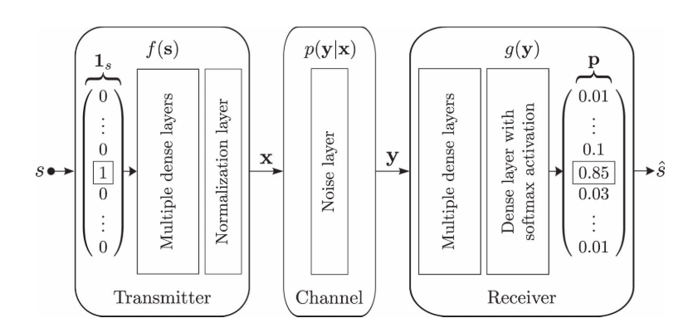
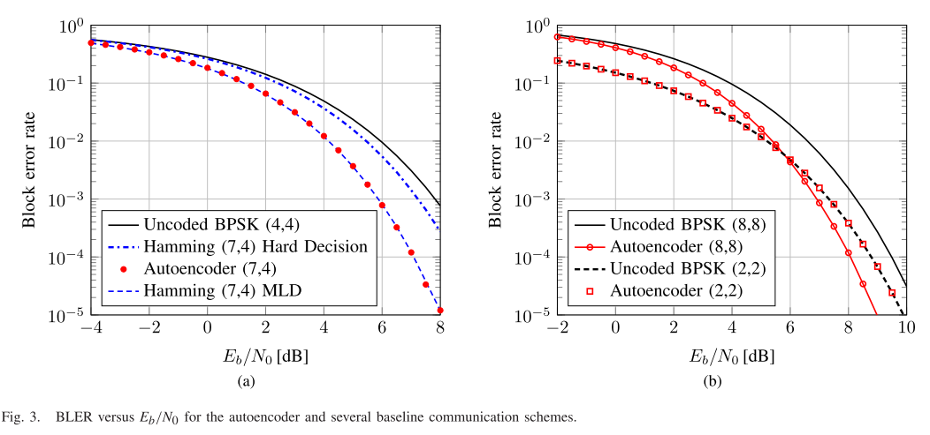
Related Work (1) Type I: Data Driven method
An auto-encoder which implement Convolution Neural Network (CNN) on raw IQ samples for modulation classification is introduced in [1]
[1]Z. Qin, H. Ye, G. Y. Li and B. F. Juang, "Deep Learning in Physical Layer Communications," in *IEEE Wireless Communications*, vol. 26, no. 2, pp. 93-99, April 2019.

Slide 5
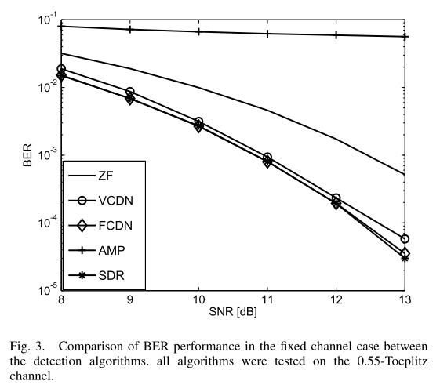
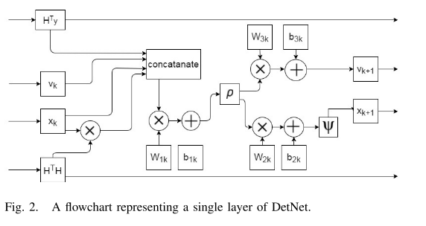
Related Work (2) Type II: Model Driven method
Deep-MIMO Detector:
DL in the context of LS-MIMO detection that build a DL-based detector called DEtNet
[11]N. Samuel, T. Diskin and A. Wiesel, "Deep MIMO detection," *2017 IEEE 18th International Workshop on Signal Processing Advances in Wireless Communications (SPAWC)*, Sapporo, 2017, pp. 1-5.

Slide 6
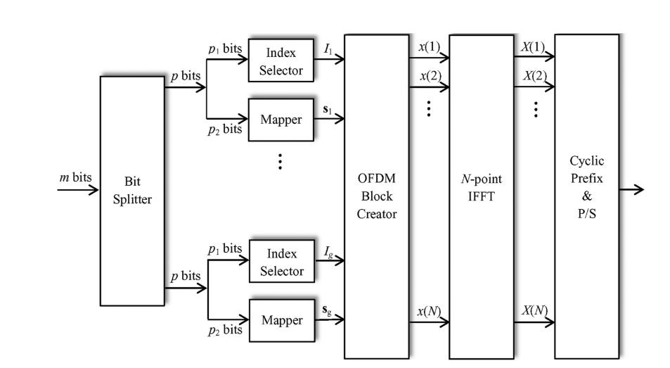
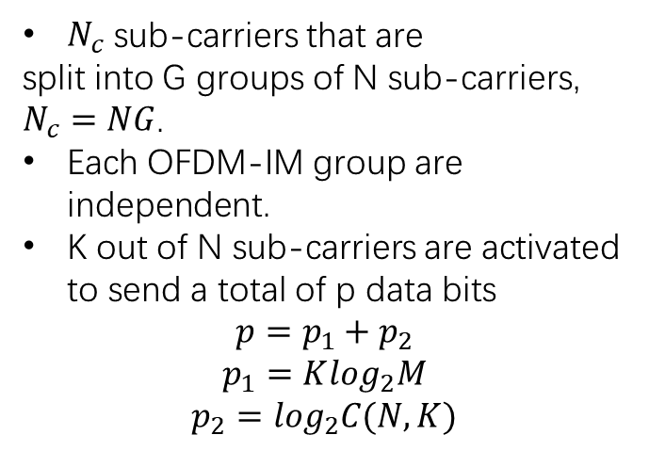
System Model: OFDM-IM (1)
$N_{c}$ sub-carriers that are
split into G groups of N sub-carriers, $N_{c}=NG$.
Each OFDM-IM group are independent.
K out of N sub-carriers are activated to send a total of p data bits
$$p=p_{1}+p_{2}$$
$$p_{1}=K\log_{2}M$$
$$p_{2}=\log_{2}C(N,K)$$
E. Başar, Ü. Aygölü, E. Panayırcı and H. V. Poor, "Orthogonal Frequency Division Multiplexing With Index Modulation," in IEEE Transactions on Signal Processing, vol. 61, no. 22, pp. 5536-5549, Nov.15, 2013.
Notes:
ESIM-OFDM: trade-off between complexity, spectral efficiency and performance by the change of the number of active subcarriers
benefits from the frequency selectivity of the channel by exploiting subcarrier indices as a source information

Slide 7


System Model: OFDM-IM (2)
(1) ML detector:
The ML detector considers all possible subblock realizations by searching for all possible subcarrier index combinations and the signal constellation points in order to make a joint decision on the active indices and the constellation symbols for each subblock by minimizing the following metric:
(2) LLR detector:
The LLR detector of the OFDM-IM scheme provides the logarithm of the ratio of a posteriori probabilities of the frequency domain symbols by considering the fact that their values can be either non-zero or zero. This ratio, which is given below, gives information on the active status of the corresponding index for each possible subcarrier.

Slide 8
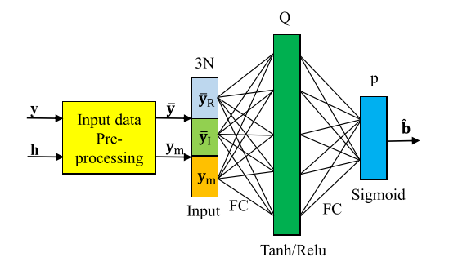

Structure of DeepIM Detector
N: subcarrier number
Q: hidden layer unit number
p: output number (bit per symbol)
y: received signal
h: channel state information
Notes:
Two fully connected layer, one hidden layer with Relu
Random initialize the parameter
With bias

Slide 9
Simulation Result (1)
Simulation env and support:
Python 3.6.3
Tensorflow 1.15.0
Numpy 1.17.4
Scipy 1.3.3
Offline Training Phase:
batch_size = 1000 (random generate data set with Rayleigh fading and AWGN)
Epoch = 10,100,300,1000
Google Colab: https://colab.research.google.com/drive/1cba8mNnZmB4QIetwnEW6225-UE0TavGQ
Github: https://github.com/liuyuchen777/Detection-and-Estiamtion-Th-final-project

Slide 10
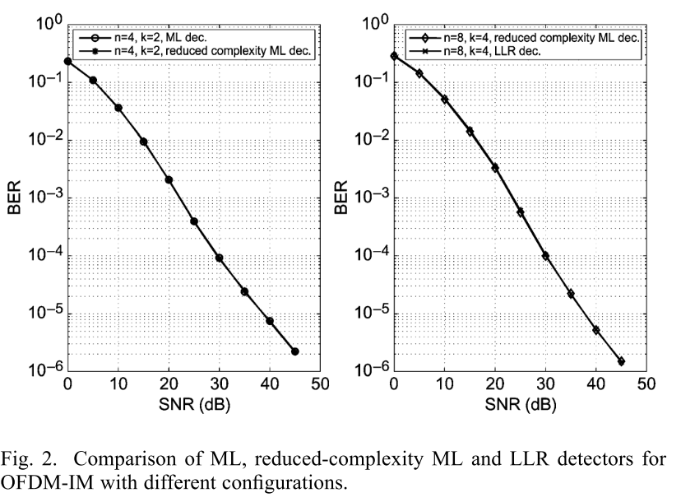
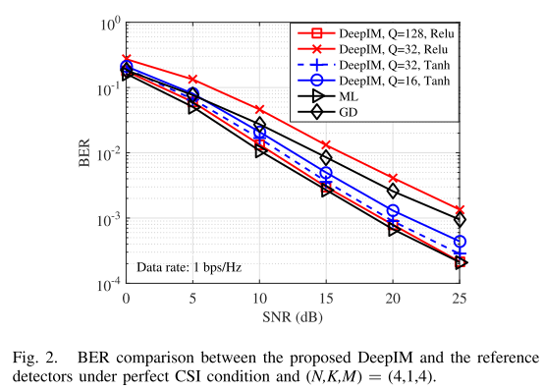
Simulation Result (2) BER under perfect CSI condition
N = 4 # number of sub-carriers
K = 1 # number of active sub-carriers
M = 4 # M-ary modulation order
SNRdb = 10 # Training SNR
[1] E. Başar, Ü. Aygölü, E. Panayırcı and H. V. Poor, "Orthogonal Frequency Division Multiplexing With Index Modulation," in IEEE Transactions on Signal Processing, vol. 61, no. 22, pp. 5536-5549, Nov.15, 2013.
[2] T. V. Luong, Y. Ko, N. A. Vien, D. H. N. Nguyen and M. Matthaiou, "Deep Learning-Based Detector for OFDM-IM," in IEEE Wireless Communications Letters, vol. 8, no. 4, pp. 1159-1162, Aug. 2019.

Slide 11
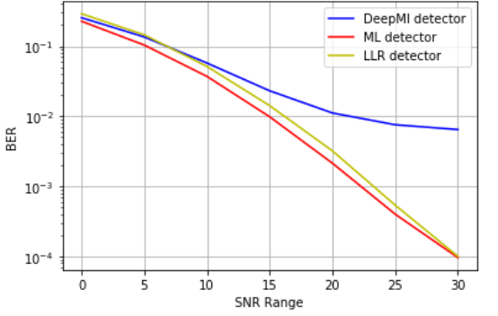
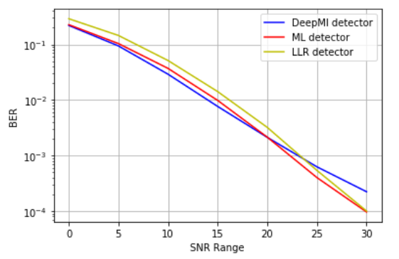
Simulation Result (3) BER under perfect CSI condition
Training Epoch = 10
Training Epoch = 100

Slide 12
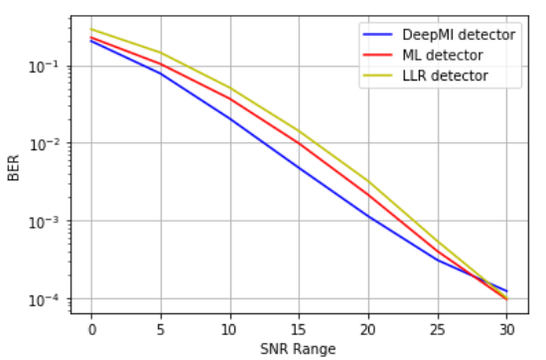
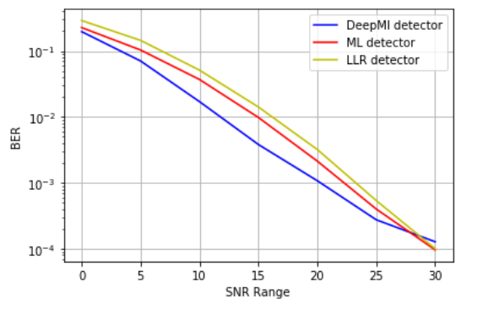
Simulation Result (4) BER under perfect CSI condition
Training Epoch = 300
Training Epoch = 300

Slide 13
Any questions?

Slide 14

Thank You !!!

